Slide 1


Hybrid Integration With BizTalk
Eldert Grootenboer
Integration Architect

Slide 2

Eldert Grootenboer
Integration Architect
Microsoft Azure MVP
SME IoT
Blogger
Published Author
International Speaker
Technet / MSDN
Boat enthusiast

Slide 3

Hybrid Integration
Hybrid Cloud
On-premises
Cloud

Slide 4
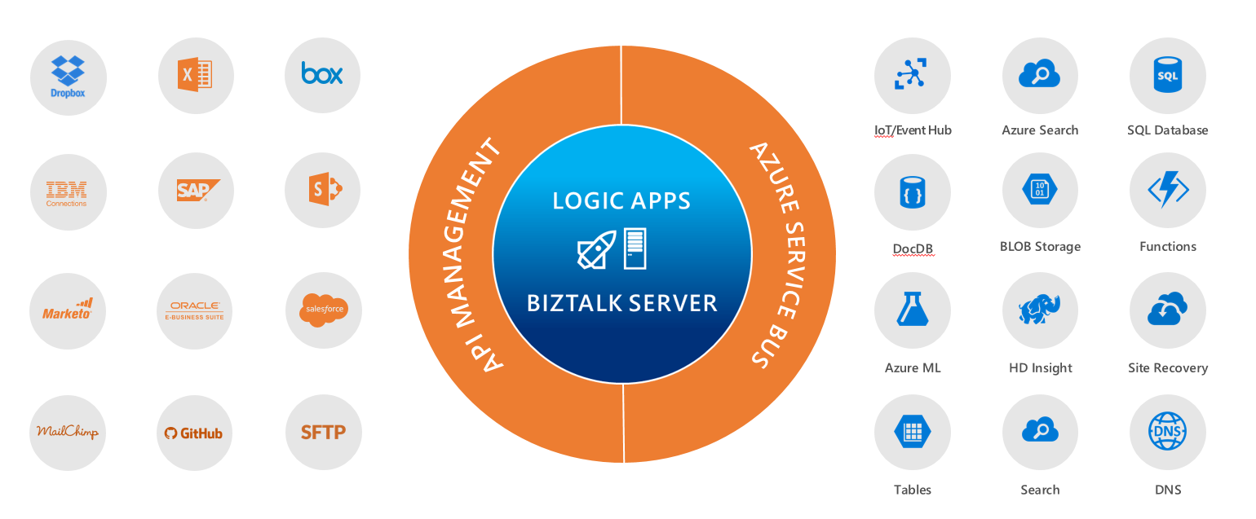
Microsoft’s Integration Vision

Slide 5
Microsoft BizTalk Server
Connect any on-premises application
Extend connectivity to the cloud
Go beyond siloed integration
Automate mission critical business processes
B2B/EDI workflows
Message brokering
Business activity monitoring
Connect to cloud applications using Azure Logic Apps Adapter
Adopt cloud on your own pace
Gain insights on your data using Microsoft cloud
Get first class integration with Azure services through the Azure Logic Apps Adapter

Slide 6
BizTalk Server 2016
Support for newer first party platforms
Windows Server 2016
SQL Server 2016
Visual Studio 2015
Office 2016
SQL Server 2016 AlwaysOn availability groups
BizTalk Server Azure VMs in production
New Azure Logic Apps Adapter

Slide 7
Azure Logic Apps
Create business processes and workflows visually
Integrate with SaaS and enterprise applications
Unlock value across on-premises and cloud
Automate EAI, B2B/EDI, and business processes
Leverage Integration Platform as a Service (iPaaS)
Transform workflows into intelligent actions

Slide 8
Message Handling
Flexibility in content types
Flexible content, binary, JSON, XML, primitives
Schema support for JSON schema and XSD
Mapping
XSLT-based – use existing assets
Visual Studio mapper to create xslt-based maps
Parameters support*
Validation
Check for errors in selected schema
Flatfile
Convert to/from flatfile – csv, delimited, positional
Built-in type conversion json<>xml<>base64
Flexible processing
Decoupled messaging from processing
Ability to send data to a batch*
Release on specific criteria e.g. size/time
Group by user-defined data (partitioning)
Or use Flush action to release batch immediately
EDI
Outbound encoders, X12, EDIFACT will make use of batching for B2B
Out of box X12 and EDIFACT schema
Leverage batching capabilities

Slide 9
Integration Account
Schemas
Maps
Trading Partners
Agreements
Certificates (KeyVault integration)
Extensible
Store your own configuration
Easy to manage
REST API, PowerShell, Portal, Visual Studio
Secure, scalable, manageable
Schemas
Maps
TPM
Custom
Config

Slide 10
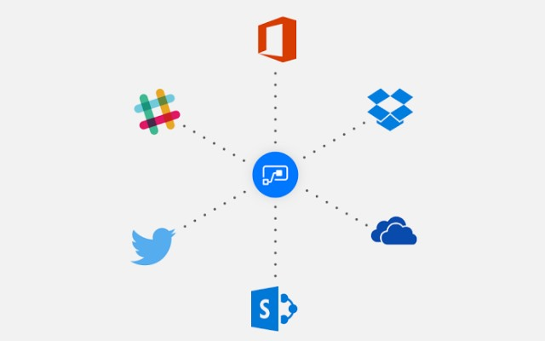
Microsoft Flow
Part of Office 365 and Dynamics 365
Free tier
Many templates to provide a starting point
Similar to IFTTT and Zapier
Create complex business flows
Consume connections, trigger events
Synchronise data
Make decisions
No (limited) code

Slide 11
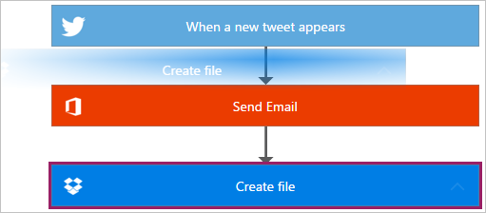
Built On Logic Apps

Slide 12
Logic Apps vs Flow
Do I lose money if this breaks?

Slide 13
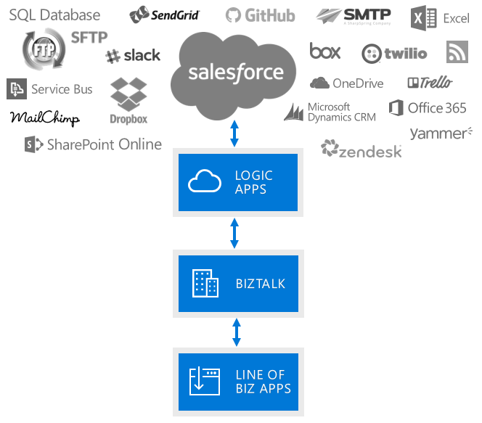
Better Together

Slide 14
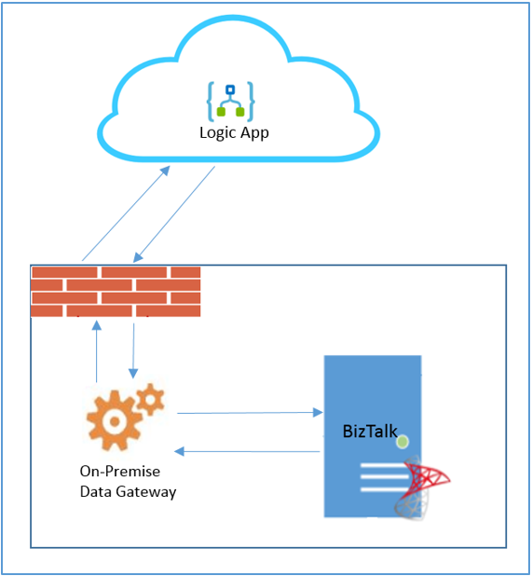
Logic Apps Adapter

Slide 15
Key Takeaways
Hybrid
On-premises is here, cloud will rise
Choose the right tool
Every tool has its own advantages and drawbacks

Slide 16



Thank You
@egrootenboer
eldert.grootenboer@motion10.com
http://blog.eldert.net/

Slide 17




Think
Share
Move

